Slide 1
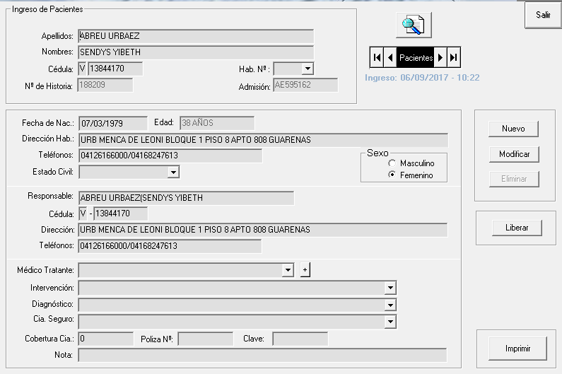
Ficha Modulo Emergencia Adulto (AE)
MODULO: EMERGENCIA
TABLA: PACIENTES
Columna | Tipo | Null
IdHistoria | numeric(18, 0) | Checked
IdFactura | numeric(18, 0) | Checked
NacionalidadPaciente | char(1) | Checked
Cedula | char(12) | Checked
Apellidos | varchar(40) | Checked
Nombres | varchar(40) | Checked
FechaNacimiento | datetime | Checked
Sexo | bit | Unchecked
IdEstado | smallint | Checked
DireccionHab | varchar(120) | Checked
TelefonosHab | varchar(30) | Checked
DireccionTrab | varchar(120) | Checked
TelefonosTrab | varchar(30) | Checked
Email | varchar(40) | Checked
Responsable | varchar(60) | Checked
NacionalidadResponsable | char(1) | Checked
CedulaResp | varchar(12) | Checked
DireccionResp | varchar(120) | Checked
TelefonosResp | varchar(30) | Checked
Alta | bit | Unchecked
IdMedico | int | Checked
IdDiagnosticoEntrada | int | Checked
IdDiagnosticoSalida | int | Checked
Nota | varchar(80) | Checked
EDAD | varchar(20) | Checked

Slide 2
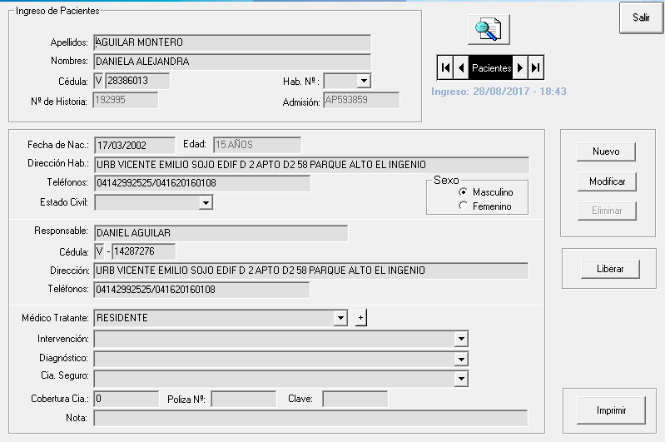
Ficha Modulo Emergencia Pediatria (AP)
MODULO: PEDIATRIA
TABLA: PACIENTES
Columna | Tipo | Null
IdHistoria | numeric(18, 0) | Checked
IdFactura | numeric(18, 0) | Checked
NacionalidadPaciente | char(1) | Checked
Cedula | char(12) | Checked
Apellidos | varchar(40) | Checked
Nombres | varchar(40) | Checked
FechaNacimiento | datetime | Checked
Sexo | bit | Unchecked
IdEstado | smallint | Checked
DireccionHab | varchar(120) | Checked
TelefonosHab | varchar(30) | Checked
DireccionTrab | varchar(120) | Checked
TelefonosTrab | varchar(30) | Checked
Email | varchar(40) | Checked
Responsable | varchar(60) | Checked
NacionalidadResponsable | char(1) | Checked
CedulaResp | varchar(12) | Checked
DireccionResp | varchar(120) | Checked
TelefonosResp | varchar(30) | Checked
Alta | bit | Unchecked
IdMedico | int | Checked
IdDiagnosticoEntrada | int | Checked
IdDiagnosticoSalida | int | Checked
Nota | varchar(80) | Checked
EDAD | varchar(20) | Checked

Slide 3
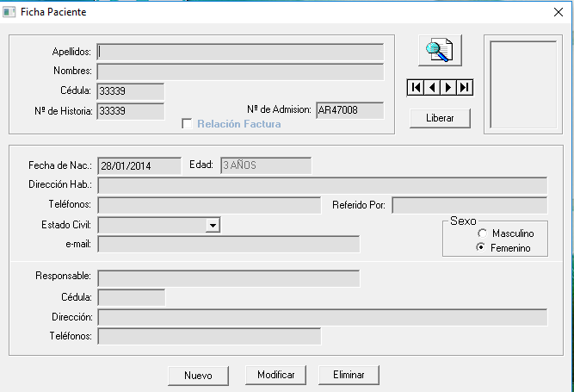
Ficha Modulo Radiologia (AR)
MODULO: RADIOLOGIA
TABLA: PACIENTES
Columna | Tipo | Null
IdHistoria | numeric(18, 0) | Checked
IdAdmision | varchar(15) | Unchecked
IdFactura | numeric(18, 0) | Checked
Cedula | nvarchar(12) | Checked
Apellidos | varchar(40) | Checked
Nombres | varchar(40) | Checked
FechaNacimiento | datetime | Checked
Sexo | bit | Unchecked
IdEstado | smallint | Checked
DireccionHab | varchar(120) | Checked
TelefonosHab | varchar(30) | Checked
DireccionTrab | varchar(120) | Checked
TelefonosTrab | varchar(30) | Checked
Email | varchar(40) | Checked
Responsable | varchar(60) | Checked
CedulaResp | varchar(12) | Checked
DireccionResp | varchar(120) | Checked
TelefonosResp | varchar(30) | Checked
Alta | bit | Unchecked
EDAD | char(15) | Checked
ReferidoPor | varchar(40) | Checked

Slide 4
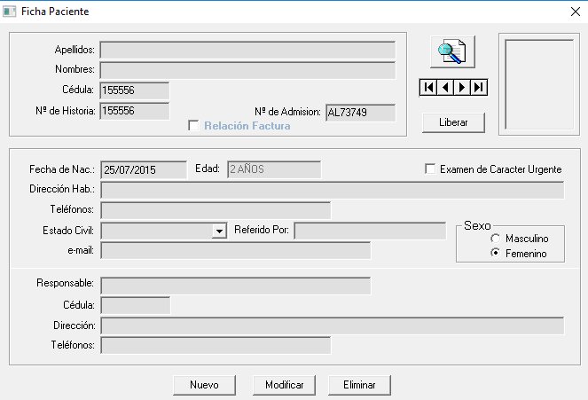
Ficha Modulo Laboratorio (AL)
MODULO: LABORATORIO
TABLA: PACIENTES
Columna | Tipo | Null
IdHistoria | numeric(18, 0) | Checked
IdAdmision | varchar(15) | Unchecked
IdFactura | numeric(18, 0) | Checked
Cedula | varchar(12) | Checked
Apellidos | varchar(40) | Checked
Nombres | varchar(40) | Checked
FechaNacimiento | datetime | Checked
Sexo | bit | Unchecked
IdEstado | smallint | Checked
DireccionHab | varchar(120) | Checked
TelefonosHab | varchar(30) | Checked
DireccionTrab | varchar(120) | Checked
TelefonosTrab | varchar(30) | Checked
Email | varchar(40) | Checked
Responsable | varchar(60) | Checked
CedulaResp | varchar(12) | Checked
DireccionResp | varchar(120) | Checked
TelefonosResp | varchar(30) | Checked
Alta | bit | Unchecked
Edad | char(15) | Checked
Urgente | bit | Unchecked
ReferidoPor | varchar(40) | Checked

Slide 5
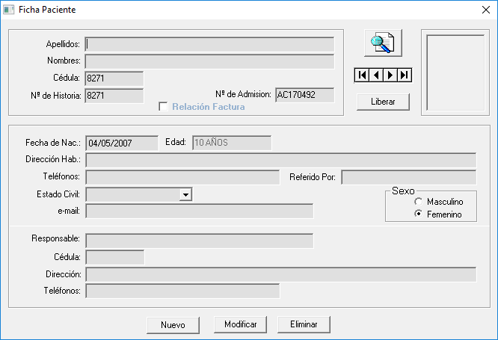
Ficha Modulo Caja (AC “Consultas-Odontologia”)
MODULO: CONSULTA
TABLA: PACIENTES
Columna | Tipo | Null
IdHistoria | numeric(18, 0) | Checked
IdAdmision | varchar(15) | Unchecked
IdFactura | numeric(18, 0) | Checked
Cedula | char(12) | Checked
Apellidos | varchar(40) | Checked
Nombres | varchar(40) | Checked
FechaNacimiento | datetime | Checked
Sexo | bit | Unchecked
IdEstado | smallint | Checked
DireccionHab | varchar(120) | Checked
TelefonosHab | varchar(30) | Checked
DireccionTrab | varchar(120) | Checked
TelefonosTrab | varchar(30) | Checked
Email | varchar(40) | Checked
Responsable | varchar(60) | Checked
CedulaResp | varchar(12) | Checked
DireccionResp | varchar(120) | Checked
TelefonosResp | varchar(30) | Checked
Alta | bit | Unchecked
EDAD | char(15) | Checked
ReferidoPor | varchar(40) | Checked

Slide 6
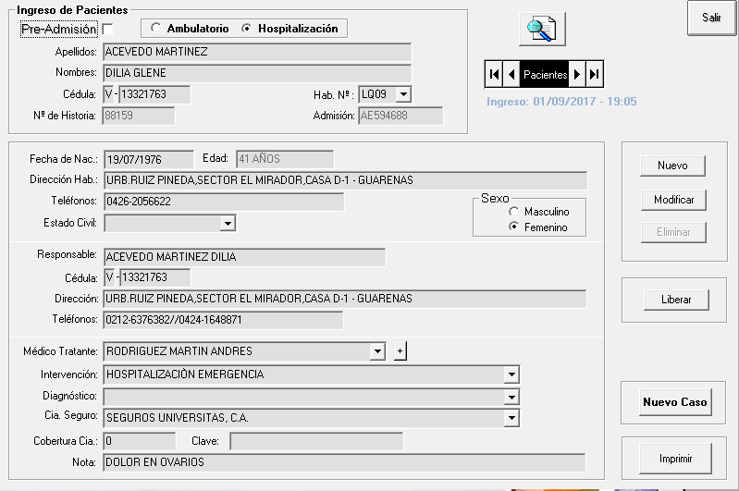
Ficha Modulo Facturacion
MODULO: COMUN
TABLA: PACIENTES
Columna | Tipo | Null
IdCedula | varchar(10) | Checked
PacienteApellido | varchar(50) | Checked
PacienteNombre | varchar(50) | Checked
IdHistoria | varchar(15) | Checked
IdAdmision | varchar(15) | Checked
PacienteHabitacion | varchar(4) | Checked
PacienteFecNac | datetime | Checked
PacienteEdoCiv | varchar(15) | Checked
PacienteSexo | varchar(10) | Checked
PacienteNac | varchar(15) | Checked
PacienteFecIng | datetime | Checked
PacienteHorIng | varchar(5) | Checked
PacienteEdad | varchar(20) | Checked
PacientePeso | real | Checked
PacienteEst | real | Checked
PacienteHabDir | varchar(90) | Checked
PacienteTraDir | varchar(90) | Checked
PacienteHabDirRes | varchar(90) | Checked
PacienteTraDirRes | varchar(90) | Checked
PacienteTelHab | varchar(30) | Checked
PacienteTelTra | varchar(30) | Checked
PacienteCel | varchar(30) | Checked
CedMedico | varchar(10) | Checked
IdDiagnostico | int | Checked
PacienteIntervencion | varchar(50) | Checked
IdCiaSeg | int | Checked
PacienteClaveCia | varchar(25) | Checked
PacienteCoberturaCia | float | Checked
OperadorSeguro | varchar(50) | Checked
PacientePolizaCia | varchar(15) | Checked
PacienteNomRes | varchar(60) | Checked
PacienteCedRes | varchar(12) | Checked
PacienteEdoRes | varchar(15) | Checked
PacienteNacRes | varchar(15) | Checked
PacienteTelHabRes | varchar(30) | Checked
PacienteTelTraRes | varchar(30) | Checked
PacienteCelRes | varchar(12) | Checked
PacientePresupuesto | bit | Checked
PacienteEmergencia | bit | Checked
PacienteMedico | bit | Checked
PacienteAlta | bit | Checked
PacienteFecEgre | datetime | Checked
PacienteHorEgre | datetime | Checked
PacienteOperador | varchar(40) | Checked
PacientePreAdmision | bit | Checked
Nota | varchar(80) | Checked
EMERGENCIA | int | Unchecked
CodTipoAfiliacion | char(10) | Checked
idContratante | int | Unchecked
IdTipoServicio | int | Unchecked
FecProbableEgre | datetime | Checked
PacientePresup | float | Checked
Email | varchar(30) | Checked

